Slide 1
Chapter 3 Extra : 2HSOE52 Introduction to Economics Chapter_3: The Simple Regression Model
Properties of Sample Regression Function

Slide 2
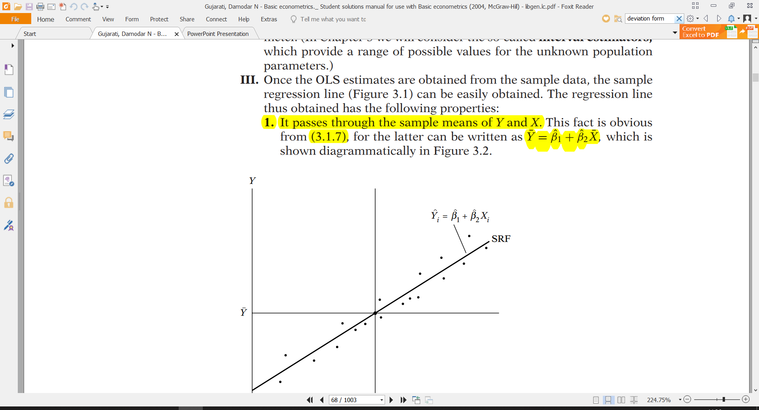
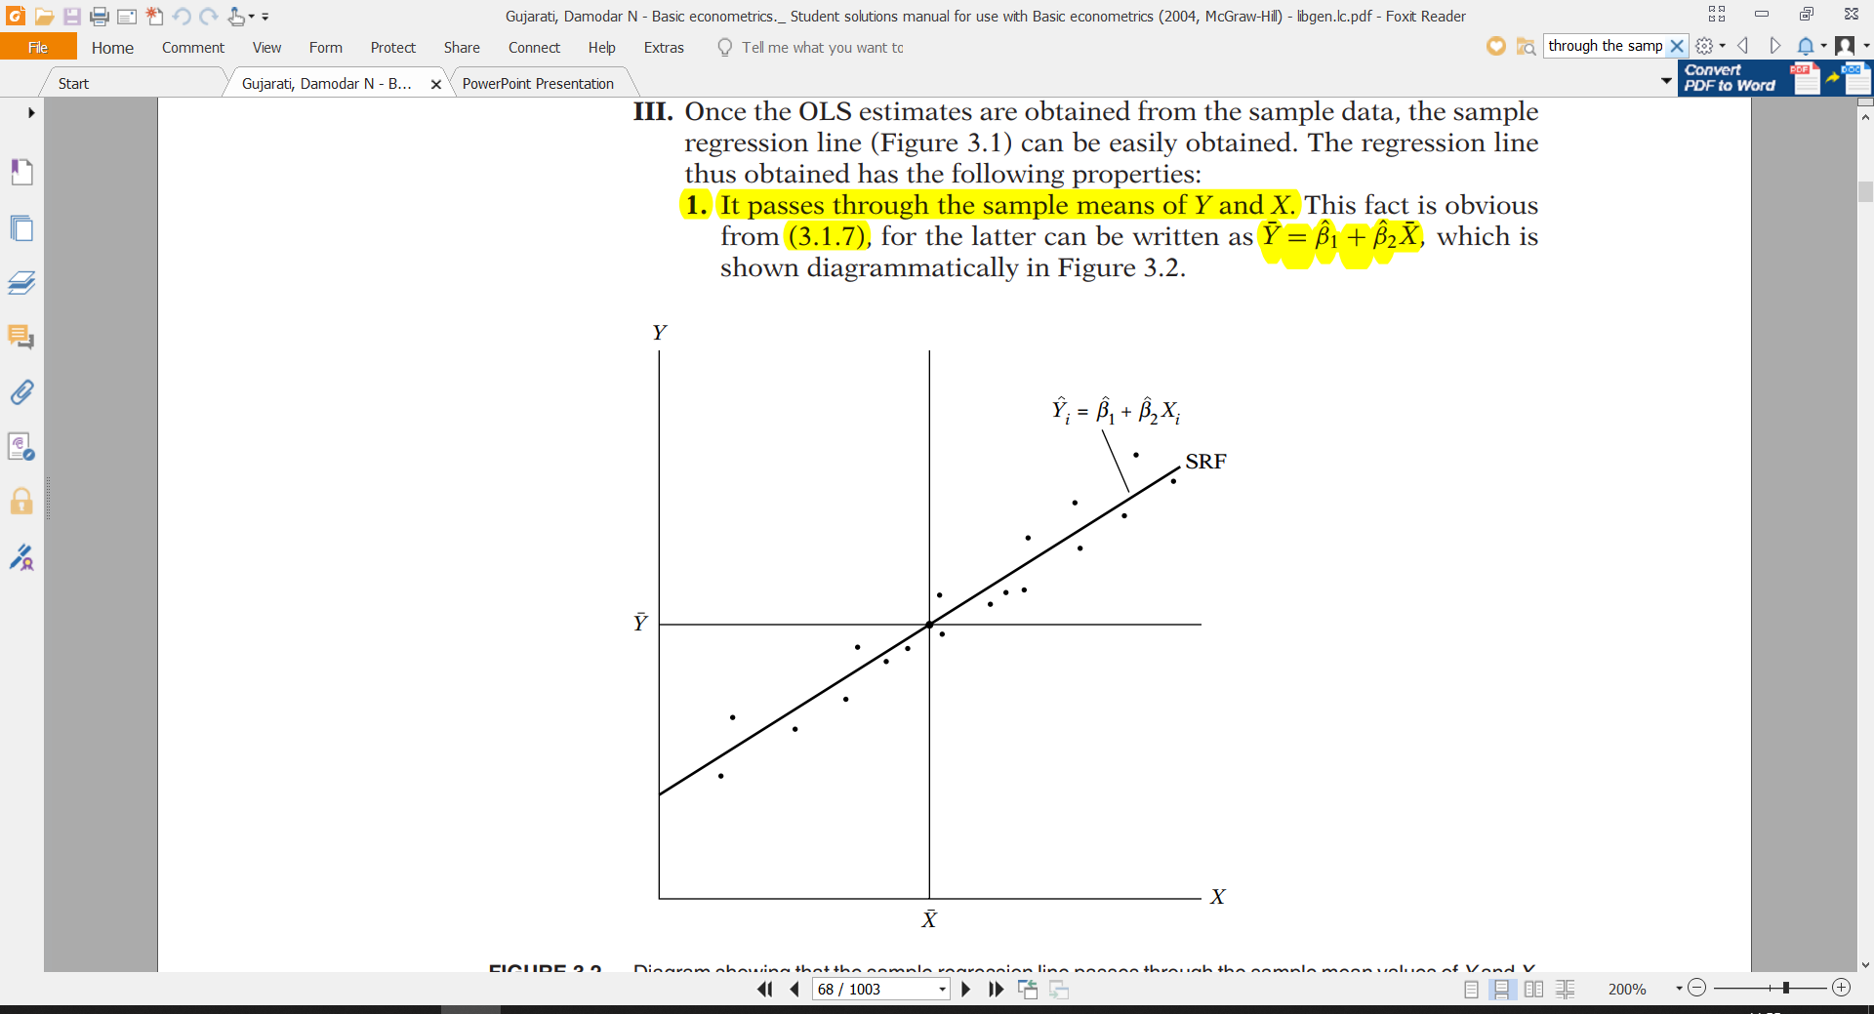
Once the OLS estimates are obtained from the sample data, the sample regression line can be easily obtained. The sample regression line has the following properties:
1. The sample regression line passes through the sample means of Y and X. Thus we can write,

Slide 3
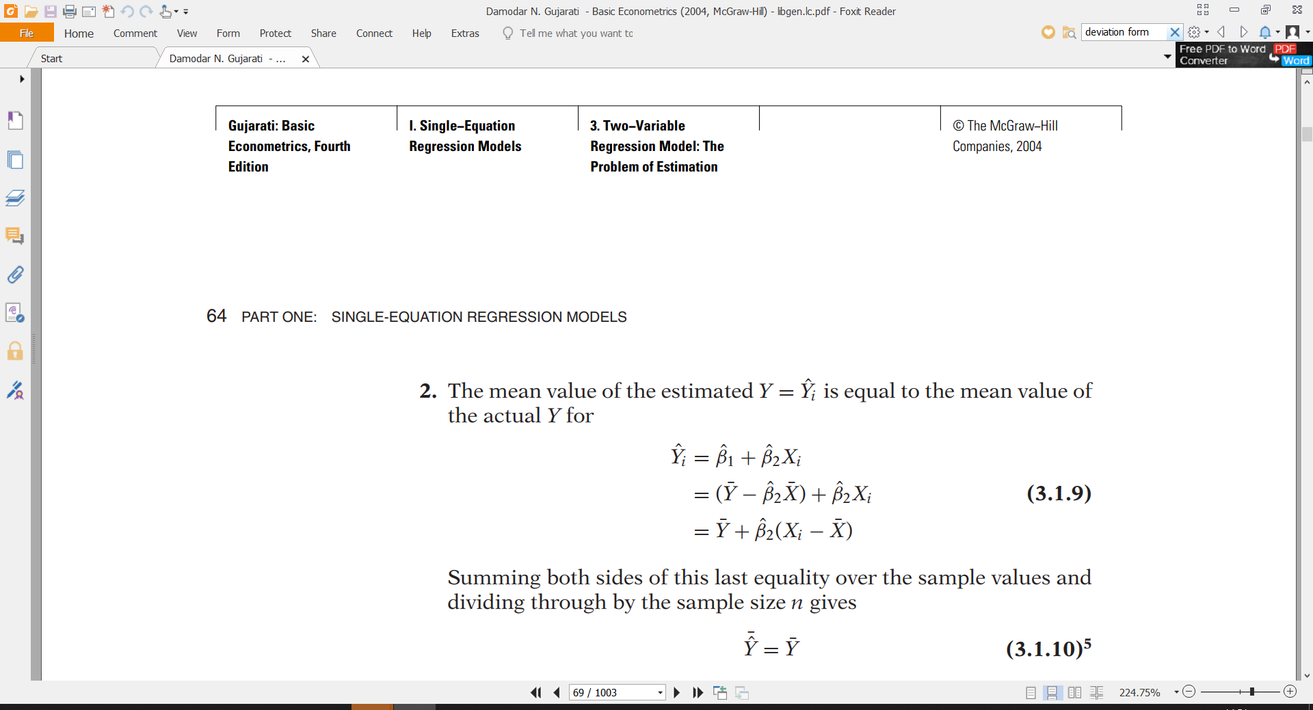
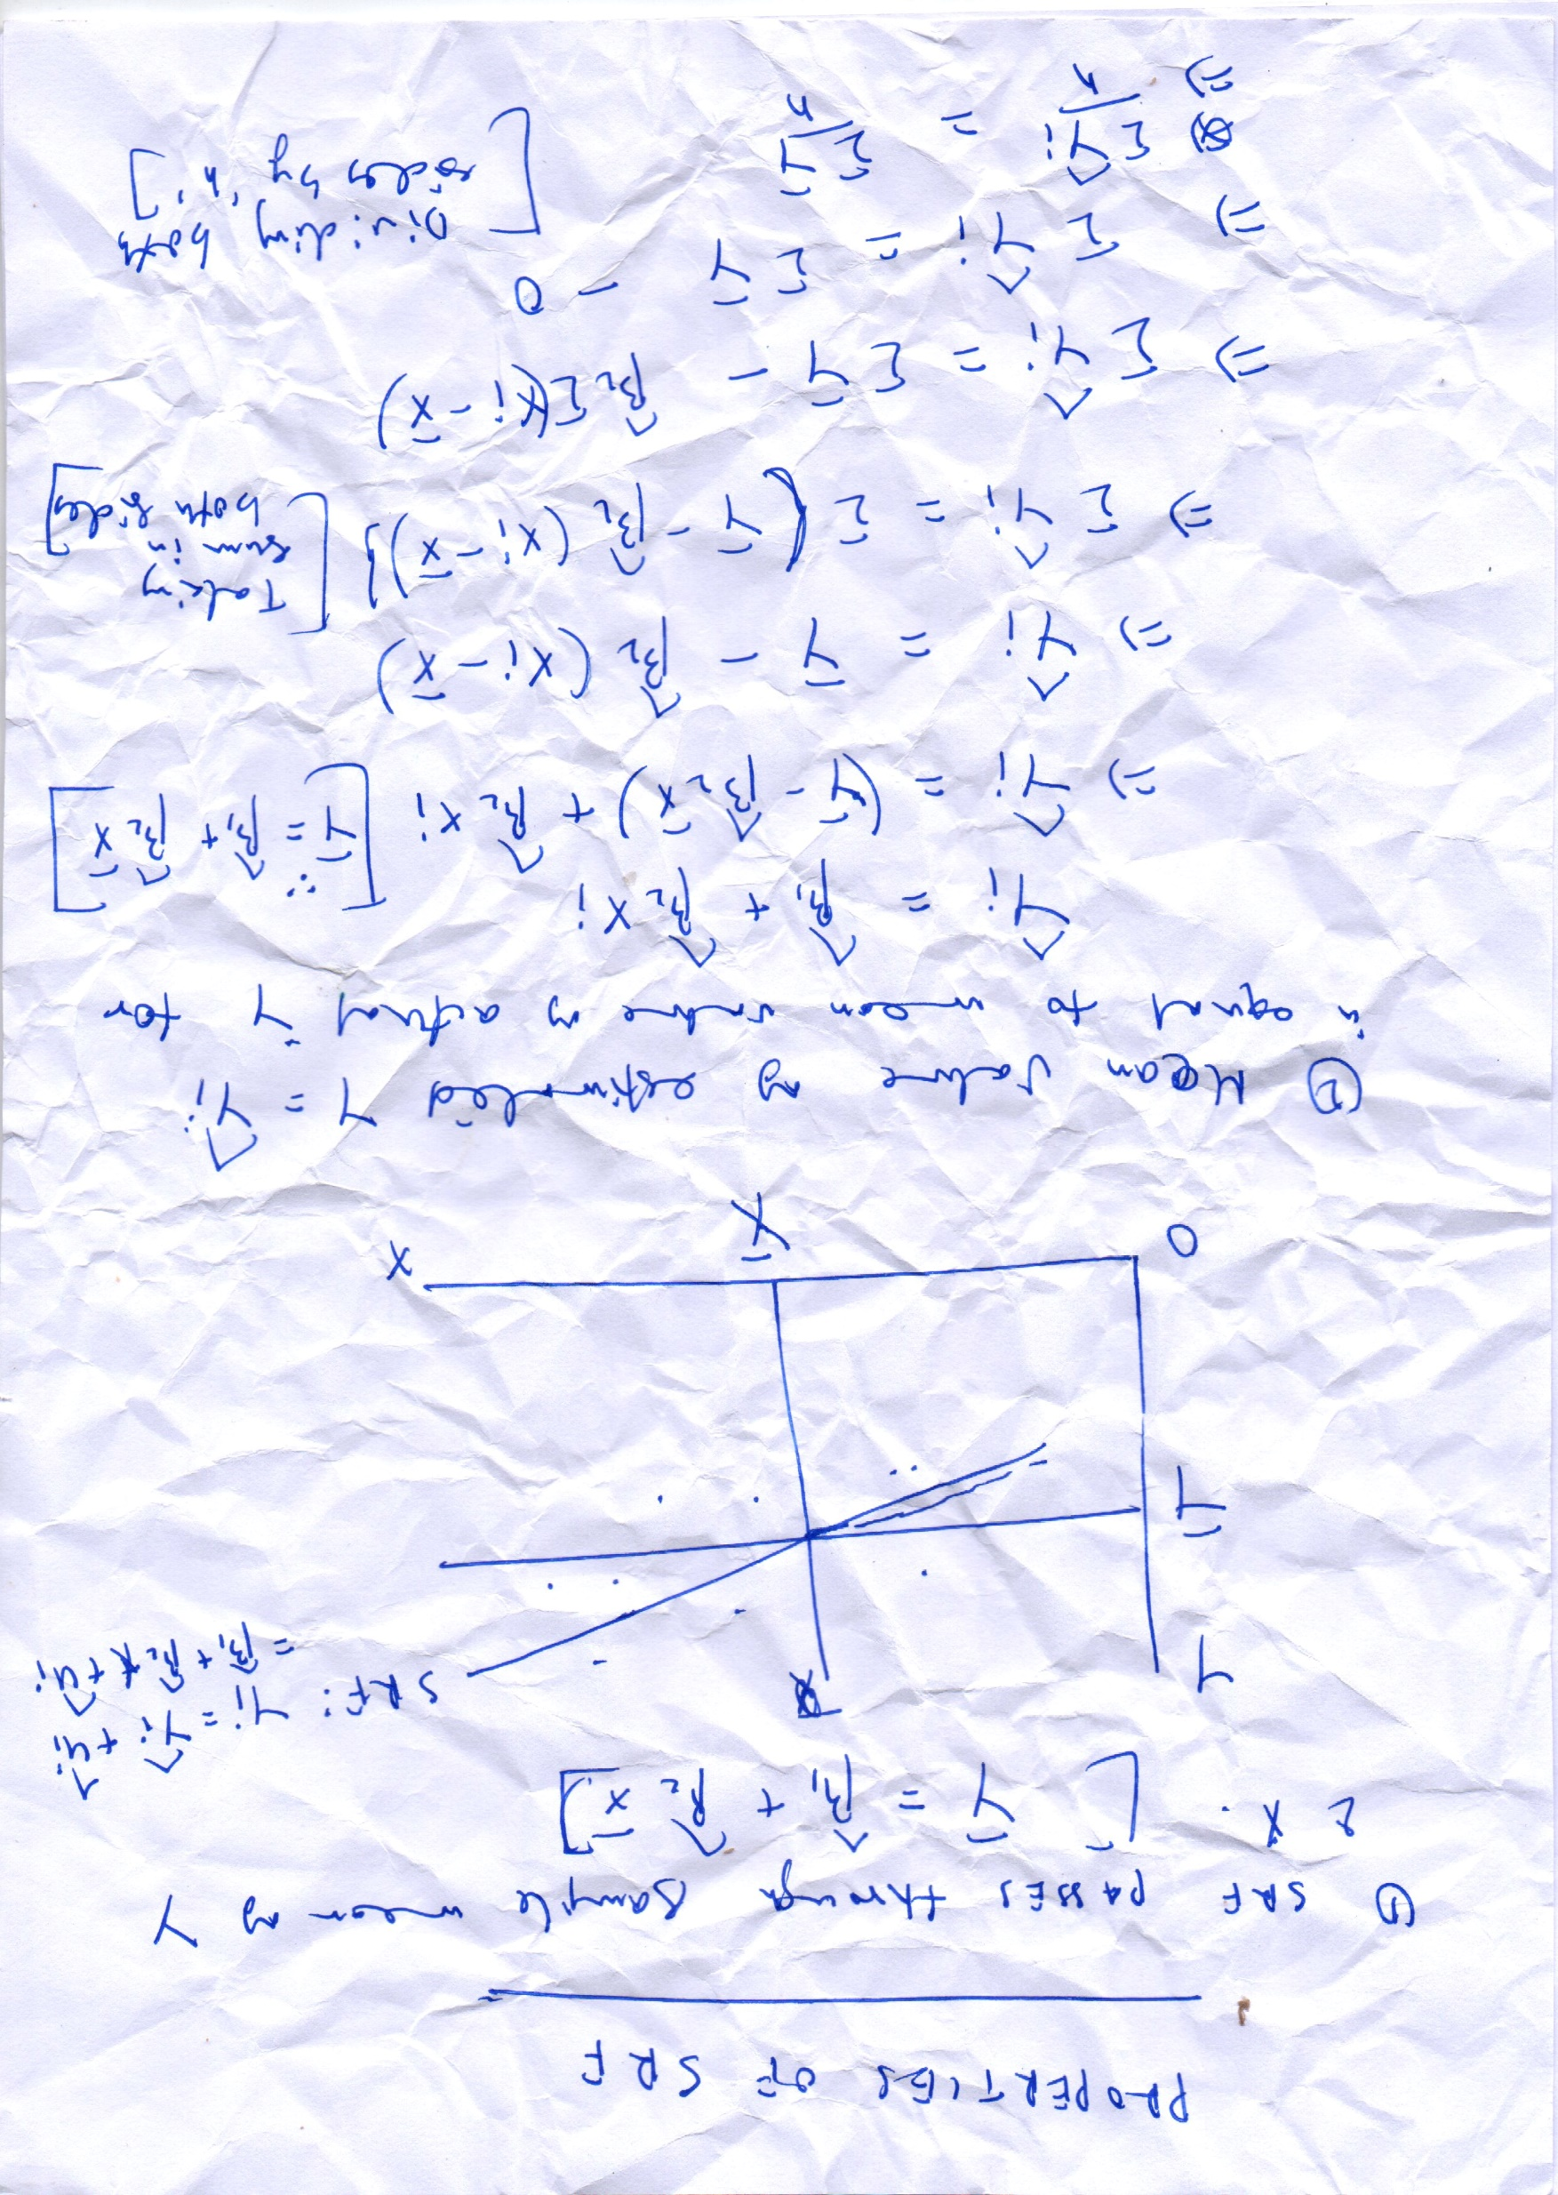
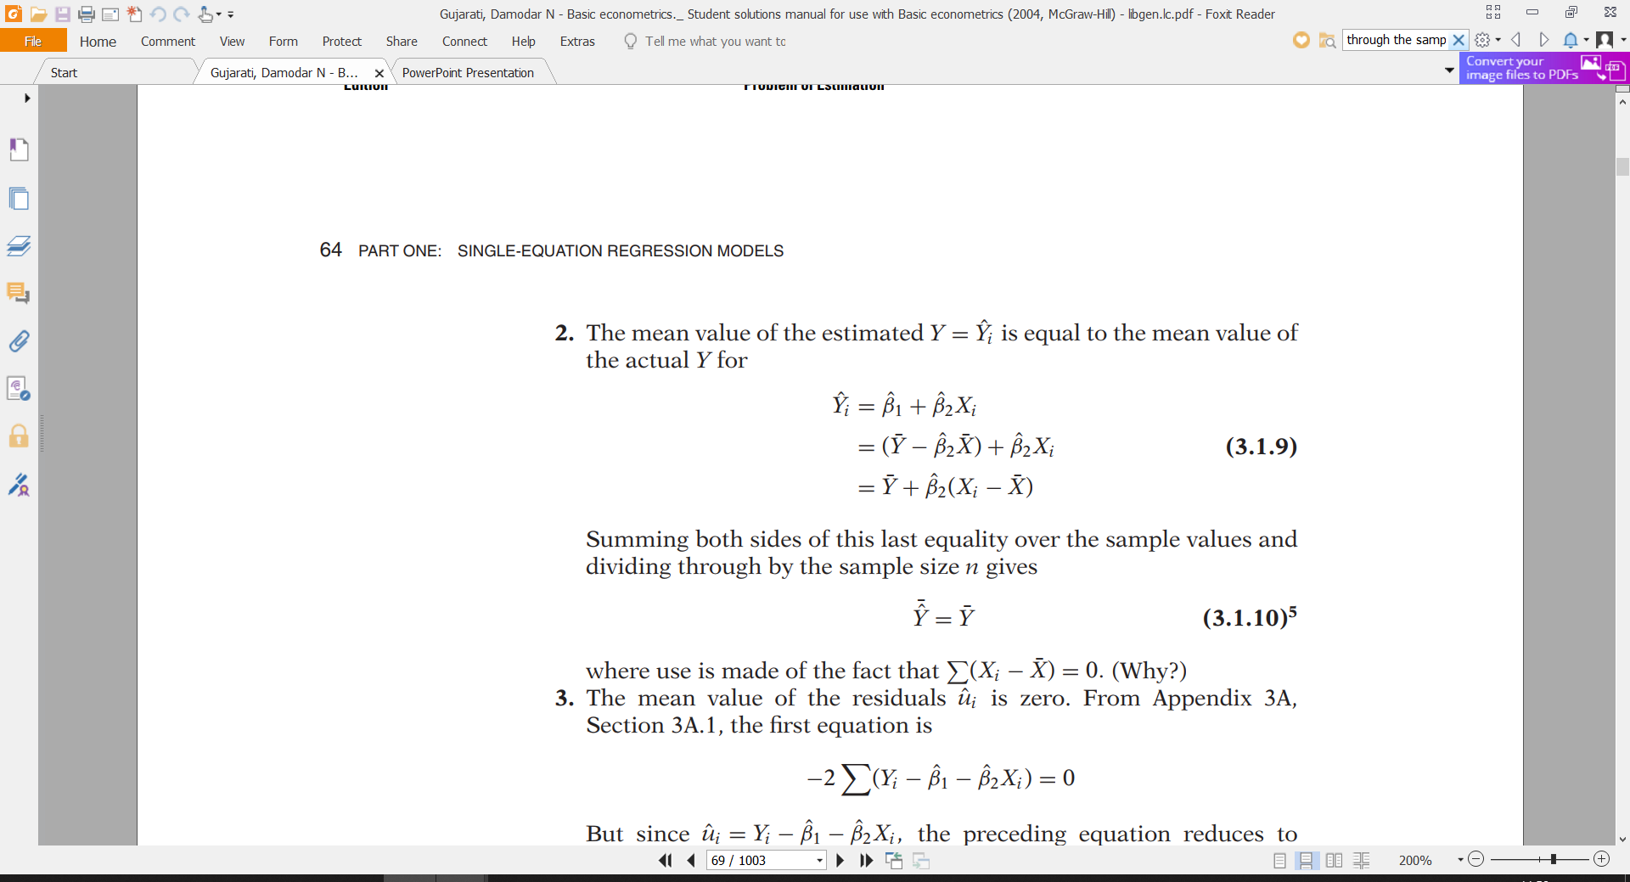

Slide 4
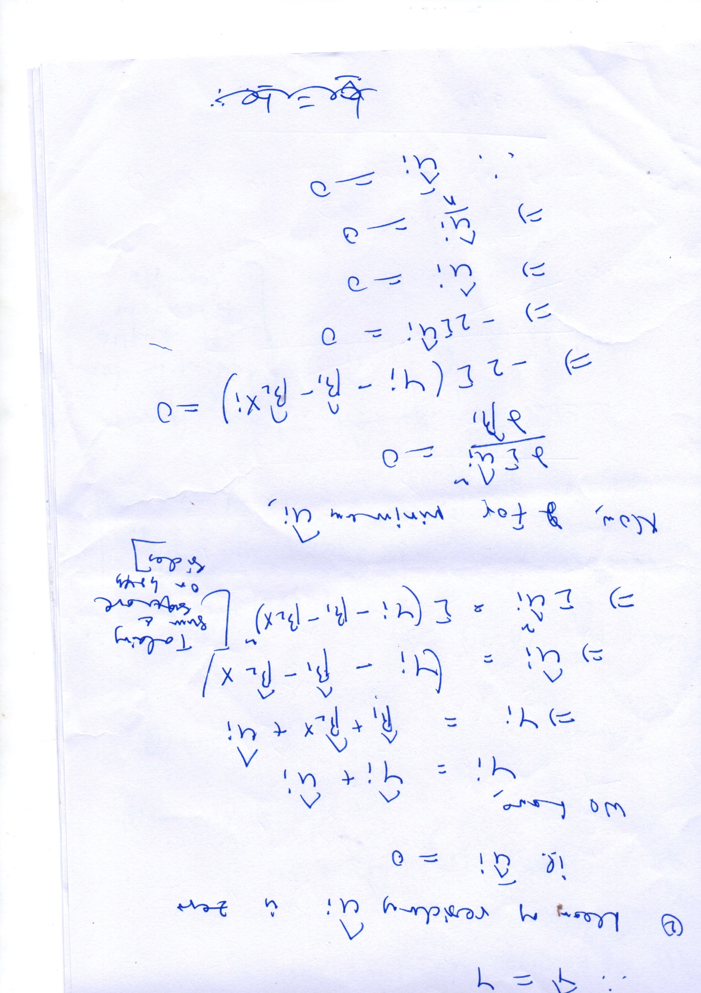
3. The mean value of the residuals uˆ_{i} is zero.

Slide 5
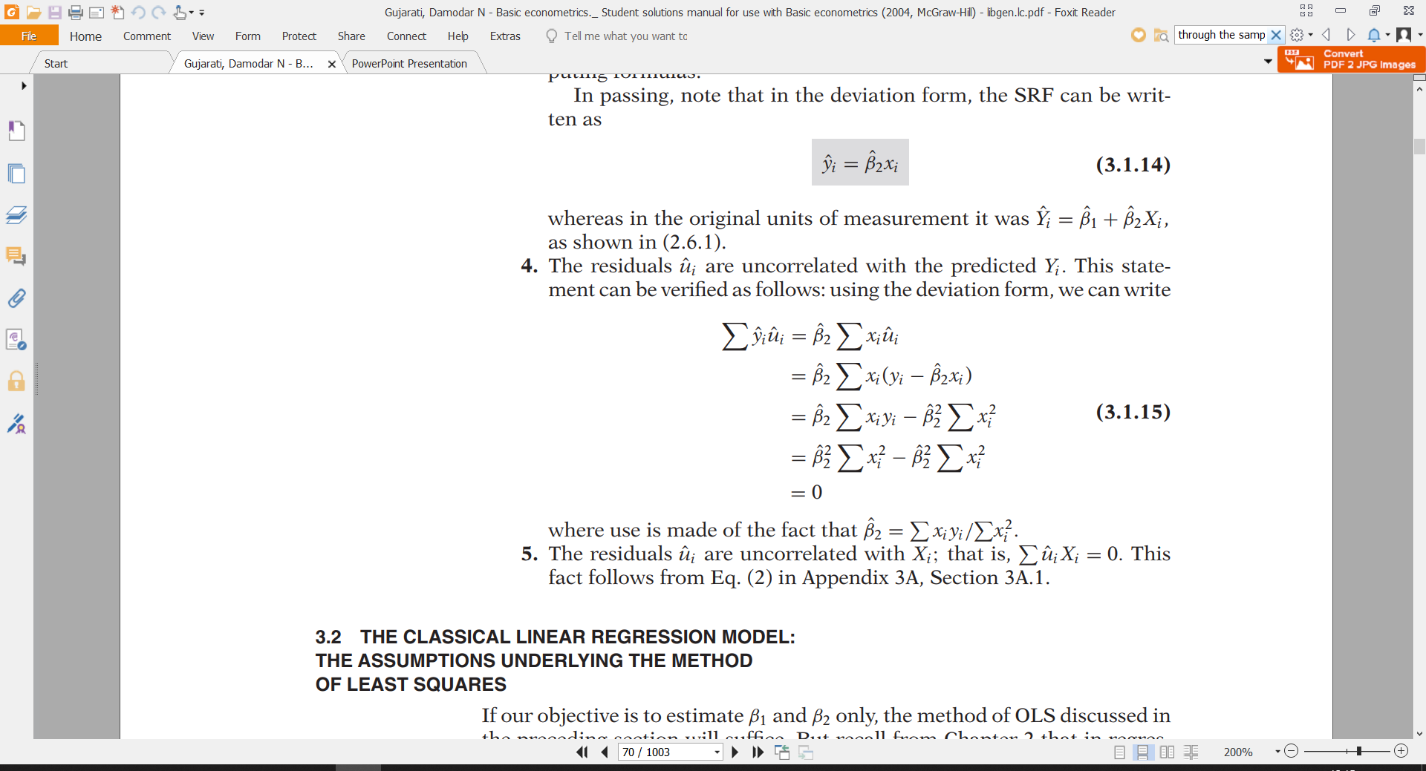

Slide 7
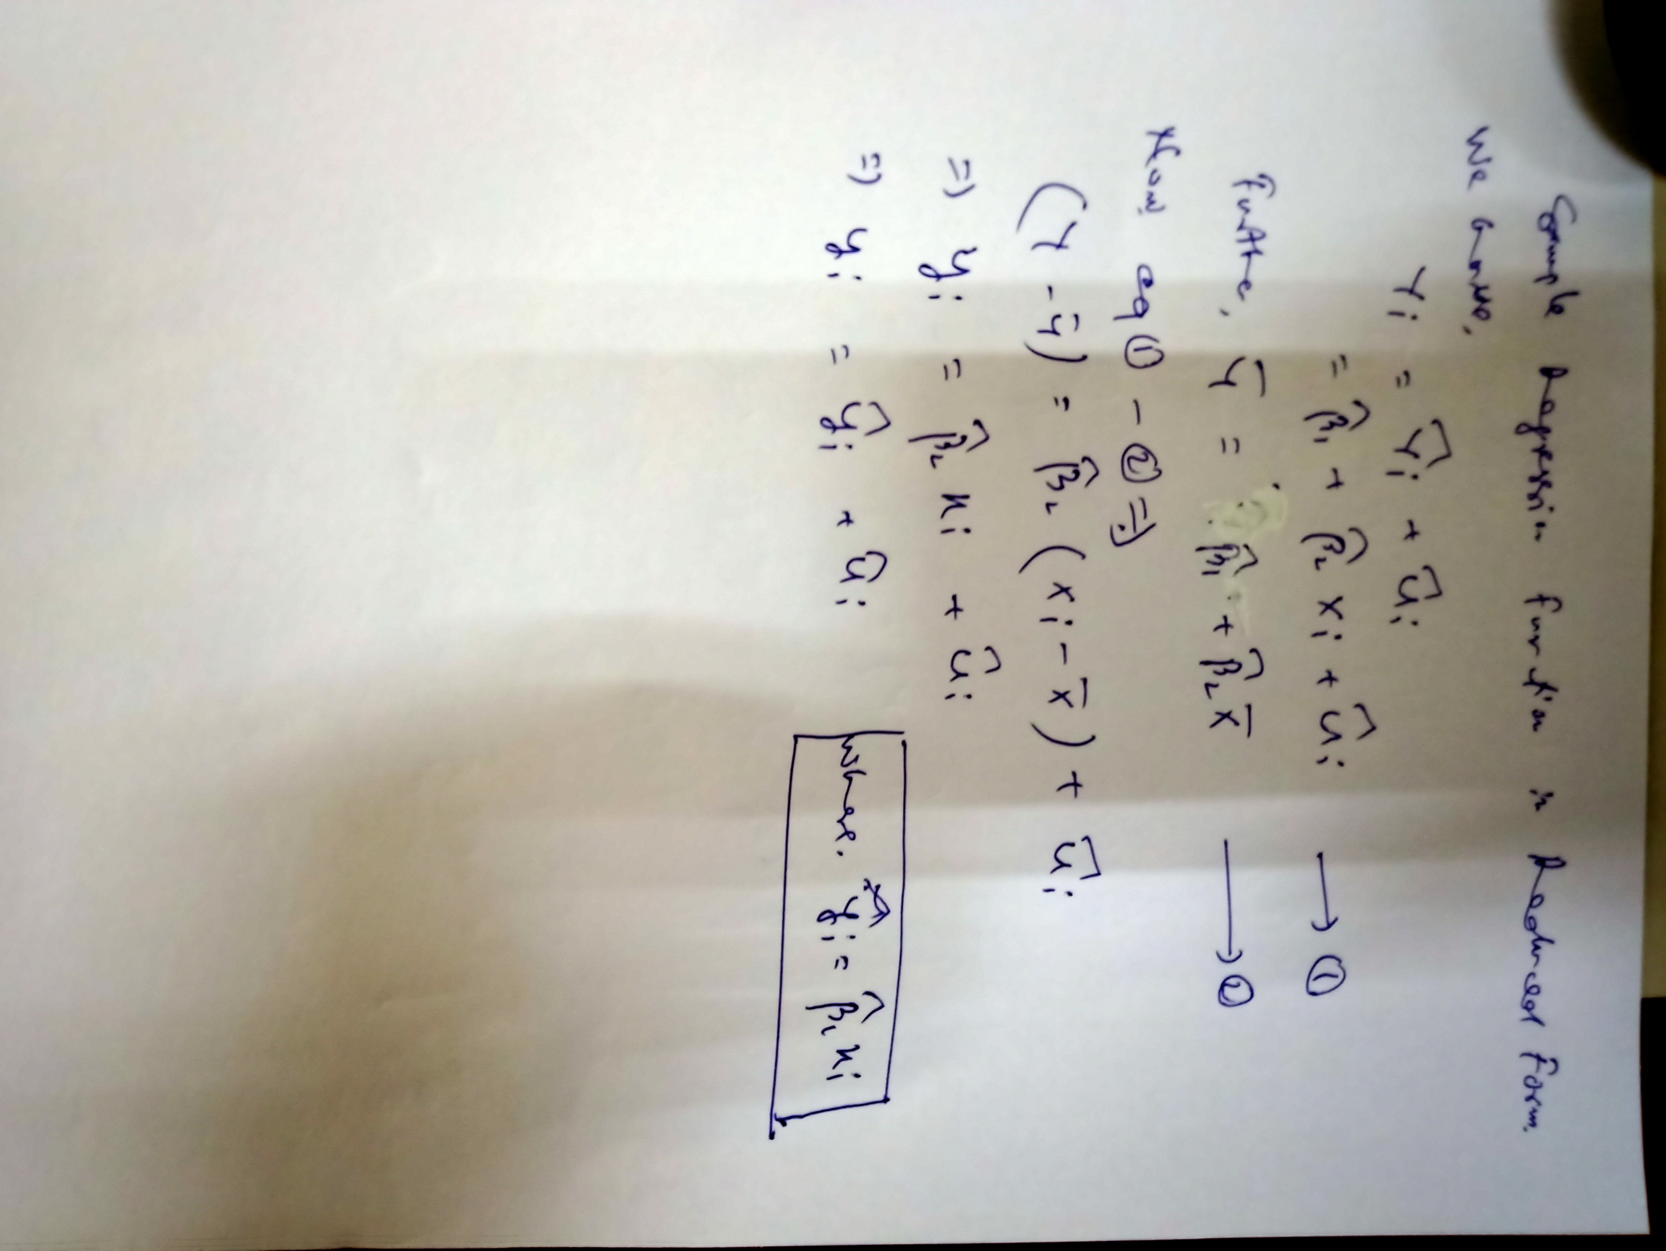
Sample Regression Function in Deviation Form
Which is SRF known as the deviation form . Intercept term βˆ1 is no longer present in it. But the deviation form simplifies the model.

Slide 8
